Slide 1
Shneiderman’s “Eight Golden Rules”
NGUYEN THANH PHUOC
Ver 1.2

Slide 2
1. Strive for Consistency
Many forms of consistency (nhất quán)
  Layout
  Sequences of action
    Ex : always confirm actions that result in data loss
  Terminology
  Color
  Capitalization
Notes:
Strive : cố gắng
Sequences of action : một chuỗi / một loạt hành động
Comfirm actions : hành động xác nhận lai
Terminology : thuật ngữ
Capitalization : cách viết hoa

Slide 3
Consistency
A system should look, act, and operate the same throughout. Similar components should
  Have a similar look
  Have similar uses
  Operate similarly
The same action should always yield the same result.
The position of standard elements should not change
Notes:
Yield : xuất ra

Slide 4
2. Enable frequent users to use shortcuts
Frequent users want to increase the pace (tốc độ)
Solution
  Abbreviations, Special keys, Hidden commands (e.g., tabbing and enter to navigate web forms)
  Macro facilities
There are 3 kind of users
  Novices
  Casual
  Expert
Notes:
Vi du :
nguoi lam viec o quay thu ngan trong sieu thi – day la nguoi thuong dung
nguoi luon nhap diem thi cho sinh vien o phong dao tao
Pace : nhanh chong, tốc độ
Novices : người tập sự
Casual : người bất chợt

Slide 5
3. Offer informative feedback
For every action there should be some kind of feedback
Frequent actions – modest natural feedback
  Ex : Mouse over, selection, …
Infrequent or major actions – substantial (clearly) feedback
Notes:
Substantial feedback : phan hoi quan trong, phan hoi chi tiet

Slide 6
4. Design dialogs to yield closure (finale)
Organize sequences of actions with a beginning, middle, end.
Feedback at the end makes it clear that the sequence has been completed, gives users feeling of accomplishment
Notes:
Accomplishment : su hoan thanh
Closure : kết thúc
Design dialogs to yield closure : thiết kế hộp thoại phải có kết thúc

Slide 7
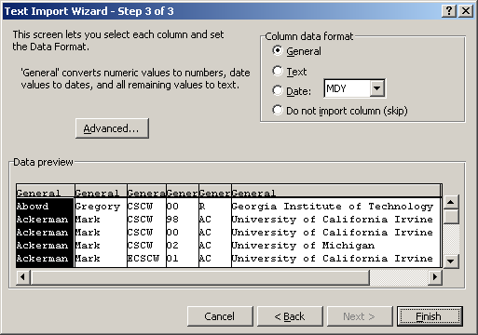
Wizards are good example

Slide 8
5. Prevent handle errors
Design the system so that users cannot make an error
  Ex: Menus offer fewer error opportunities than form filling
Logically constrained choices must be physically constrained (Ex select State, don’t type it)
Erroneous actions should leave the system state unchanged
Notes:
Gracefully : trang nha
Erroneous actions : hanh dong sai lam

Slide 9
Common type of errors
Mode Errors
Description Errors
Capture Errors
Activation Errors
Sequence Errors
Command Errors

Slide 10
a.Mode Errors
Mode errors occur when users think they are in one state but are actually in another
Such as
  Delete Folder in Window Explorer but not update tree of folder.
  Delete a source file but still see in IDE.

Slide 11
b.Description Errors
Ambiguous or incomplete specification of intention
Organize screen displays functionally
Such as
  Remove and Delete command

Slide 12
c.Capture Errors
Occur when there is an overlap in the sequence required for two different operations.
  Such as capture 2 object in power point
    Power Point : don’t solve
    IDE : solve good

Slide 13
d.Activation Errors
Inappropriate actions are performed or appropriate actions fail to get performed
Ex : login screen

Slide 14
e.Sequence Errors
Provide Complete Sequences
  Should be guided by knowledge of user tasks – what is a complete sequence?

Slide 15
f.Command Errors
Correct Commands
  Automatic command completion
  Menu selection
Make it hard to do irreversible (không thay đổi được) actions – provide interlocks
Notes:
Irreversible : khong the dao nguoi
Interlocks : su cai vao nhau

Slide 16
6. Permit easy reversal of actions
Actions should be reversible
Provide an undo function
Allowing exploration: lets users learn and gain confidence
Notes:
Reversal : đảo ngược

Slide 17
7. Support internal locus of control
Experienced users want to be in control
  Ex: “Build” versus “auto-build” of Eclipse
Make users the initiators of actions rather than responders
emphasize direct manipulation,
de-emphasize computer-as-autonomous-agent
Notes:
Tedious data : dữ liệu nhàm chán
Locus dia diem

Slide 18
8. Reduce short term memory load
Limitations on short term memory
Keep displays simple
Provide on-line access to command syntax
Notes:
Load (a) ganh nang
Reduce short term memory load : giam di ganh nang phai nho nhung khai niem ngan

Slide 19
Eight Golden Rules
Strive for Consistency
Enable frequent users to use shortcuts
Offer informative feedback
Design dialogs to yield closure
Prevent-Handle errors gracefully
Permit easy reversal of actions
Support internal locus of control
Reduce short term memory load

